Slide 1
Bank Loan Case Study
Bank Loan Case Study
By Gayatri Palkar

Slide 2
Contents
Project Objective
Data Preprocessing
Data Analytics Tasks
Project Report
Video Presentation Link

Slide 3
Project Objective

Slide 4
Project Objectives
Identify Patterns in Customer Attributes that Influence Loan Default
Understand Loan Attributes and Their Impact on Default Likelihood
Risk Analysis to Minimize Financial Loss

Slide 5
Data Preprocessing

Slide 6
Understanding the data
We have three files -
application_data.csv: Contains information about loan applicants
previous_application.csv: Contains information about applicants previous loan applications
columns_description.csv: Provides descriptions of the columns in the above two files
We will use the datasets to understand the factors that influence whether a loan applicant will have difficulties in repaying the loan.

Slide 7
Data Analytics Tasks

Slide 8
Data Analytics Tasks
Identify Missing Data and Deal with it Appropriately
Identify Outliers in the Dataset:
Analyze Data Imbalance
Perform Univariate, Segmented Univariate, and Bivariate Analysis
Identify Top Correlations for Different Scenarios

Slide 9
Task 1
Identify and Handle Missing Data

Slide 10
Identify and Handle Missing Data
Identify Columns with High Missing Rates - Columns with a high proportion of missing values might need further investigation to determine if they should be excluded or if there is a pattern in the missingness
Imputation Choice - The method of imputation (mean, median, mode) should be chosen based on the data type and the nature of the missing values.
For instance, average or median is suitable for numerical data, while mode is better for categorical data. We can also use Forward or Backward fill for Categorical imputation

Slide 11
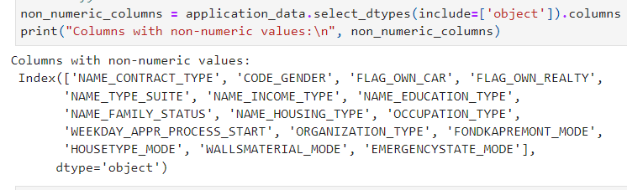
Identify and Handle Missing Data
Steps to get to solution -
Identify Missing rows in a column =COUNTBLANK($A$2:$A$50000)
Remove the columns having more that 50% null values
Determine columns having categorical values, Find the blanks of all the categorical data columns for eg column NAME_TYPE_SUITE and fill the missing values in it using Mode of the column using formula =MODE(E:E)

Slide 12
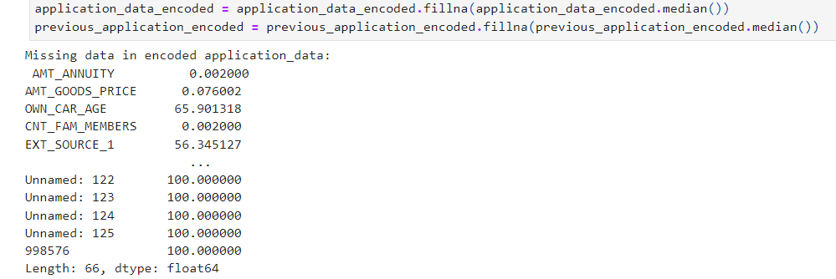
Identify and Handle Missing Data
Steps to get to solution continued-
Identify Missing values in numerical data and fill them with the Median of that column, using formula =MEDIAN(G2:G50000)
Used python for this, attached is the code:

Slide 13
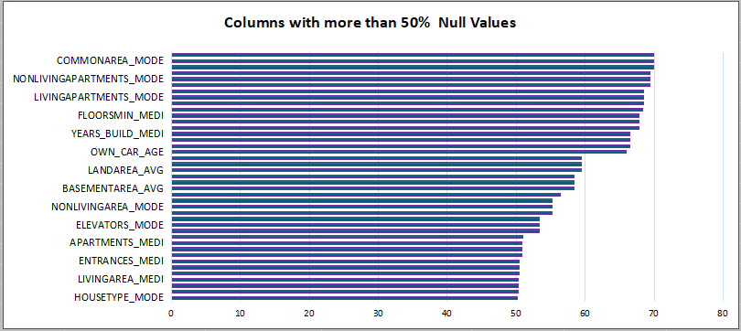
Identify and Handle Missing Data
Steps to get to solution continued-
For columns having more than 50% nan or missing values, I decided to remove the columns completely
For the OCCUPATION_TYPE column, I decided to rename the Blank columns as “Unknown”
For the numerical columns, I decided to take the median of the columns as it won’t be affected by any outliers, unlike mean of data

Slide 14
Task 2
Identify Outliers in the Data

Slide 15
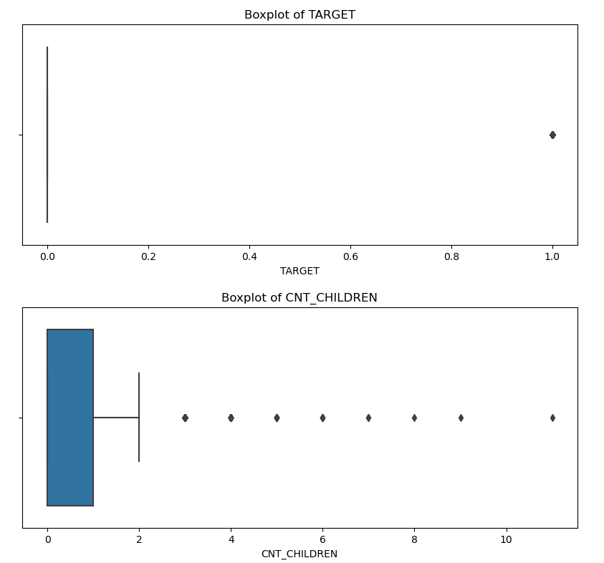
2. Identify Outliers in the Data
Outliers are extreme values that deviate significantly from the rest of the data. They can indicate variability in the dataset, potential errors, or significant events.
To detect outliers, we will have to plot a box plot.
Since I don't have “Boxes and Whiskers” feature in my WPS office, I decided to plot a boxplot using Python

Slide 16
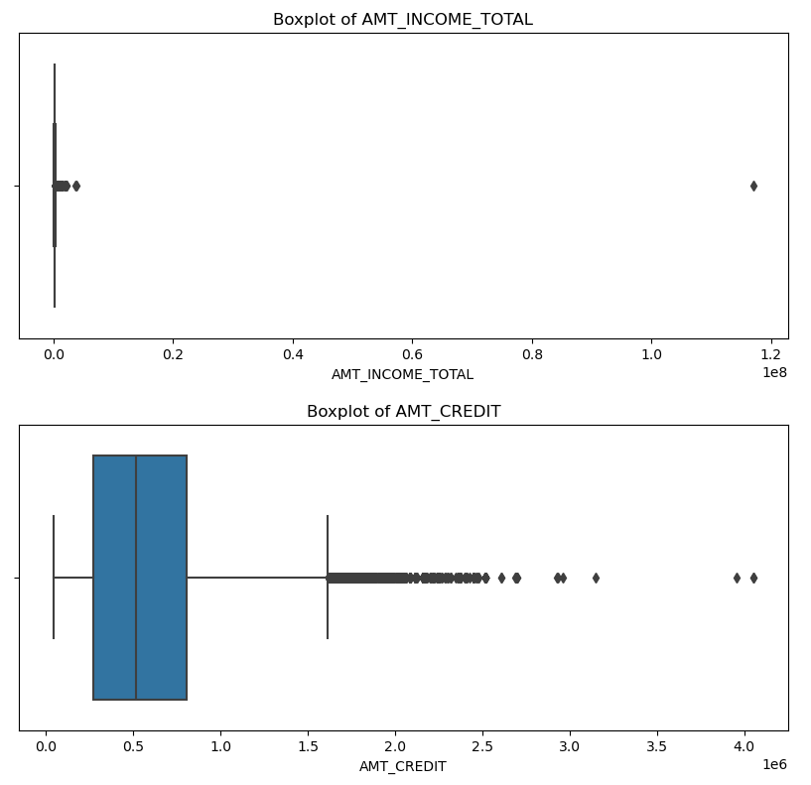
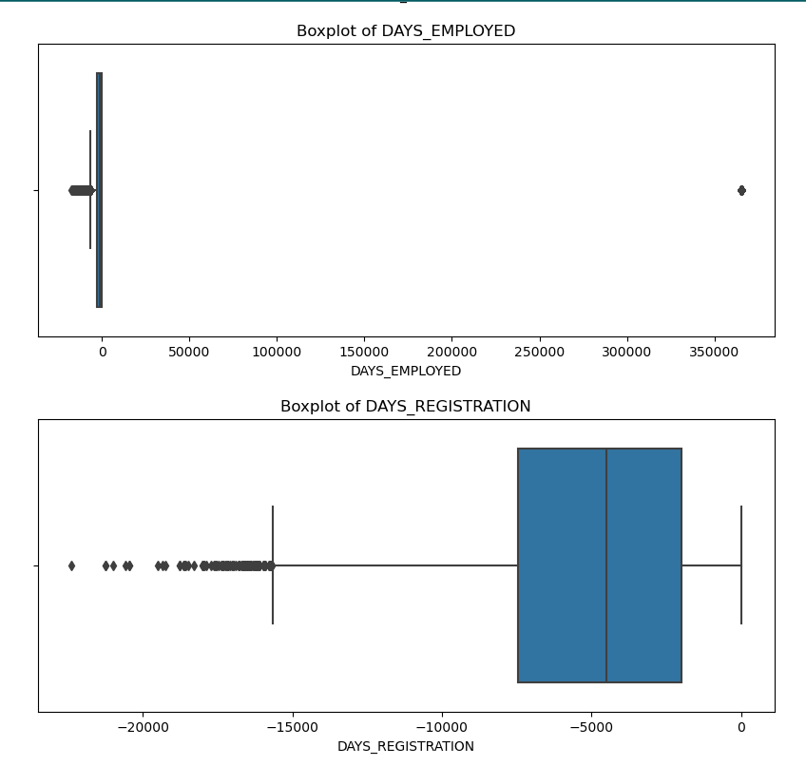
2. Identify Outliers in the Data

Slide 17
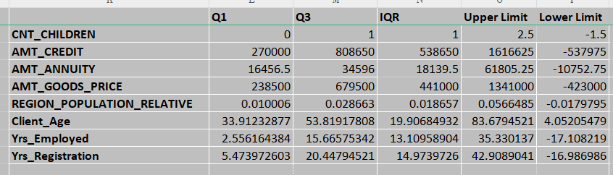
2. Identify Outliers in the Data
Box plots visualize the distribution of data, showing the median, quartiles, and potential outliers, helping to understand data spread and detect anomalies.
To detect the outliers, I will start by finding the Min and Max values from column
Then I will find the Median, Q1 and Q3 using QUARTILE function:=QUARTILE(G:G,1) and =QUARTILE(G:G,3) and =MEDIAN(G2:G7152)
Then find the Interquartile range(IQR) using formula: =M22-M20 i.e Q3 - Q1

Slide 18
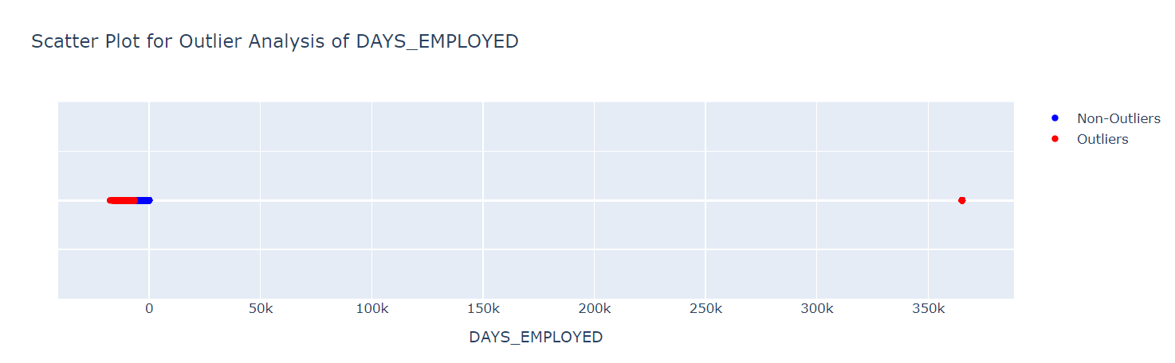
2. Identify Outliers in the Data
The outliers are very far away from out data and hence will not provide a meaningful insight, so I will remove the outliers completely from the data
The Outliers are now deleted, I will also delete or hide the new column Outliers as our job for cleaning the data is done.
I will now start with further analysis
Outlier
Actual Data

Slide 19
After removing missing columns and rows
After removing Outliers from Data
Data count becomes
50000 rows and 89 columns
Data count becomes
41070 rows and 73 columns

Slide 20
Task 3
Analyze Data Imbalance

Slide 21
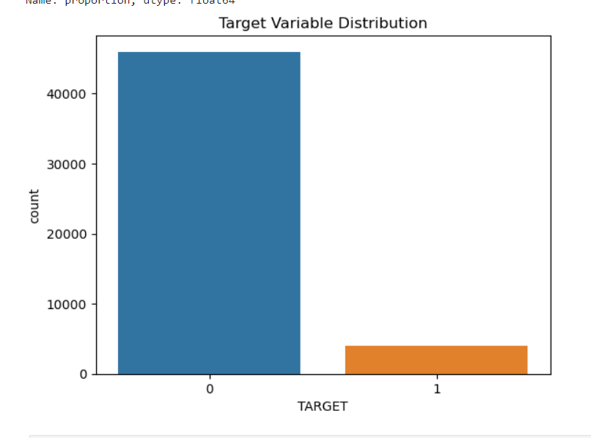
3. Analyze Data Imbalance
Data Imbalance refers to the uneven distribution of classes in the dataset. For instance, if one class significantly outnumbers others, the model may be biased towards predicting the majority class.
Impact of Imbalance:
Model Performance: Imbalanced data can lead to poor model performance, where the model might predict the majority class well but perform poorly on the minority classes.
Decision Making: Understanding the class distribution helps in making decisions about whether to apply techniques like resampling (over-sampling the minority class or under-sampling the majority class) or using algorithms robust to class imbalance.

Slide 22
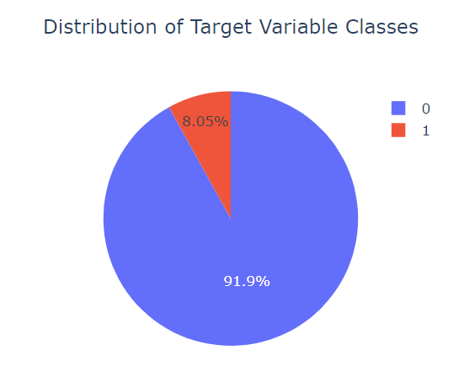
Pie Chart Visualization
0 | represents all other cases (Non-Defaulters) | 8.05%
1 | represents clients with payment difficulties (Defaulters) | 91.9%

Slide 23
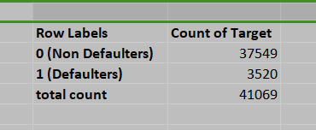
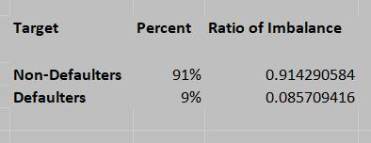
Using Excel
Insights:
The dataset is highly imbalanced, with a significant majority of instances belonging to class 0 (Non-Defaulter-91%) and a minority belonging to class 1 (Defaulter-9%)
Predicting class 1 accurately may be difficult due to its minority representation.

Slide 24
Task 4
Perform Univariate, Segmented Univariate, and Bivariate Analysis

Slide 25
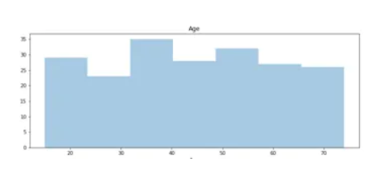
4. Perform Univariate, Segmented Univariate, and Bivariate Analysis
Univariate Analysis analyzes individual variables. It helps to understand the distribution and summary statistics of each variable separately.
Segmented univariate analysis summarizes a single variable by dividing it into subsets to observe patterns across segments. It helps identify central tendencies (mean, mode, median), range, and variability (variance, standard deviation).
Bivariate Analysis examines the relationship between two variables. It helps to understand how two variables interact or influence each other.

Slide 26
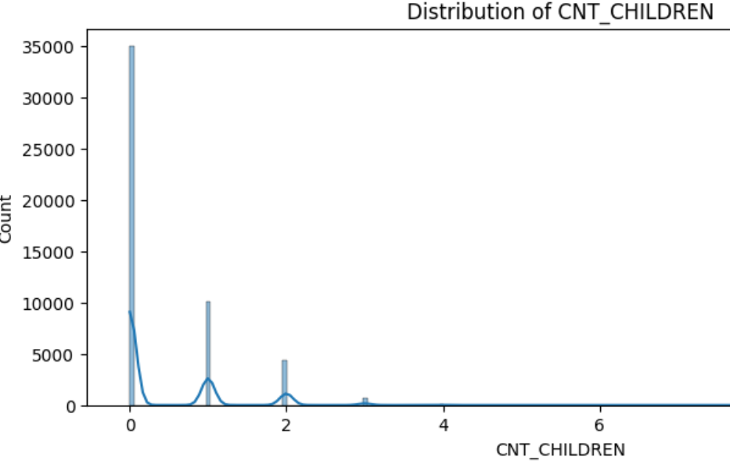
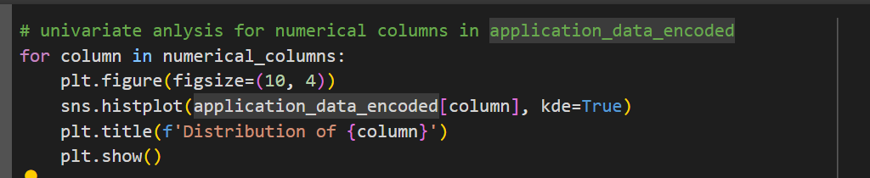
Univariate Analysis
Using Python

Slide 27
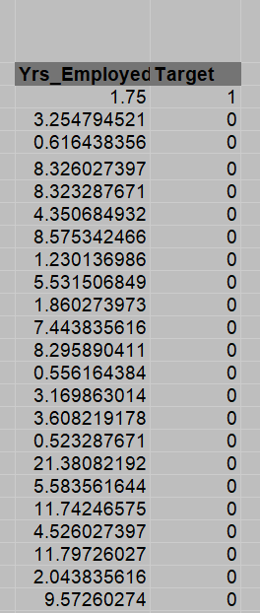
Univariate Analysis
Steps using Excel:
Univariate Analysis:
Use COUNT, AVERAGE, MEDIAN, and STDEV functions to analyze individual variables.
Create histograms for distributions: Select the data range and insert a histogram.
Segmented Univariate Analysis:
Use filters or pivot tables to segment data by different loan outcomes and analyze distributions.
Bivariate Analysis:
Use scatter plots to analyze relationships between two variables. Select the two variables and insert a scatter plot.

Slide 28
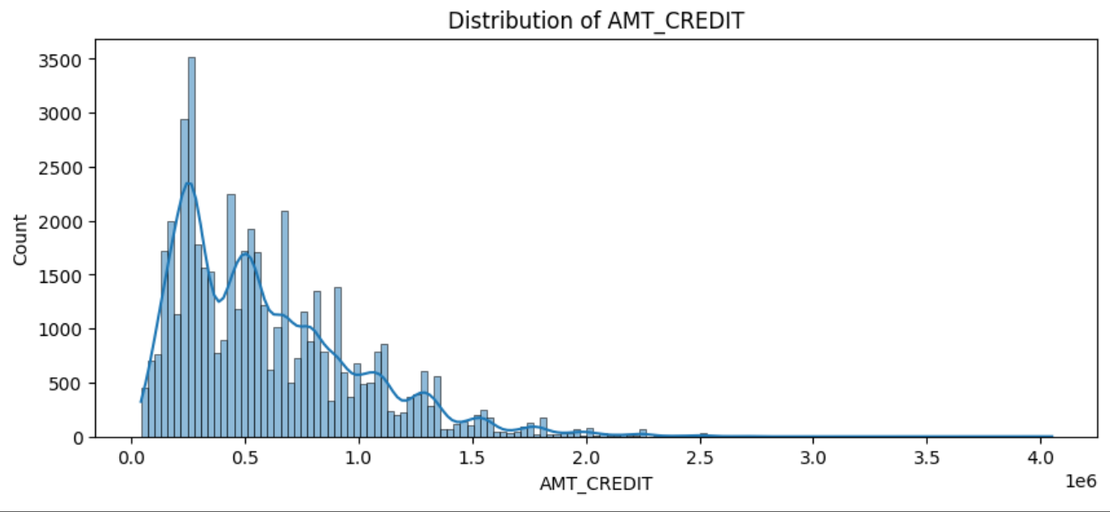
Univariate Analysis

Slide 29
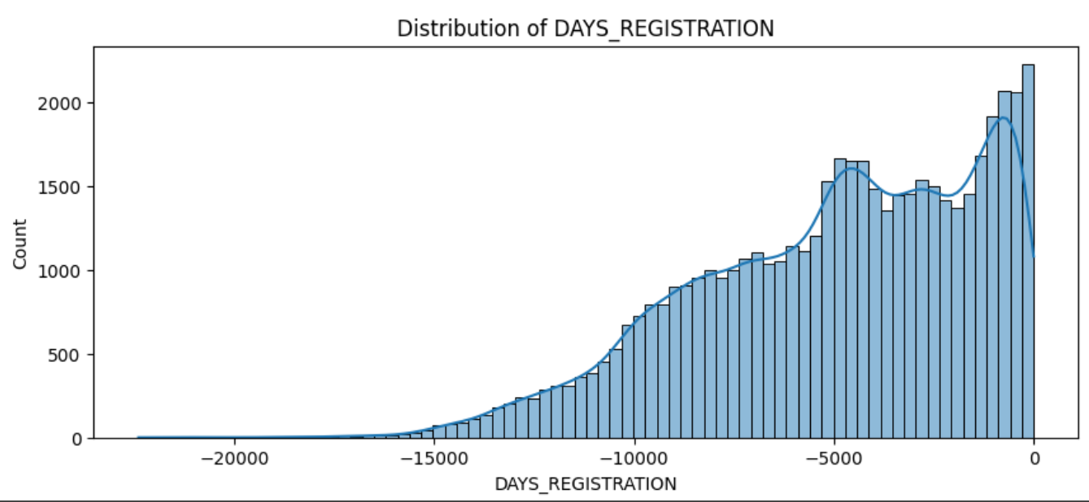
Univariate Analysis

Slide 30
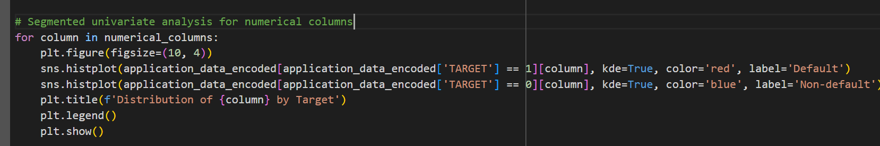
Segmented Univariate Analysis
Using Python

Slide 31
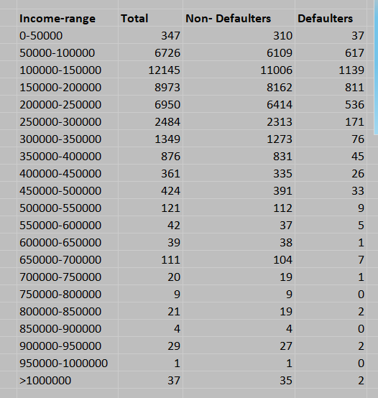
Segmented Univariate Analysis
Using Excel
Using Pivot Tables:
Select your data range.
Go to Insert > PivotTable.
Drag variables to rows and columns to compare distributions.
Use the Values area to display summary statistics like count, average, or median.

Slide 32
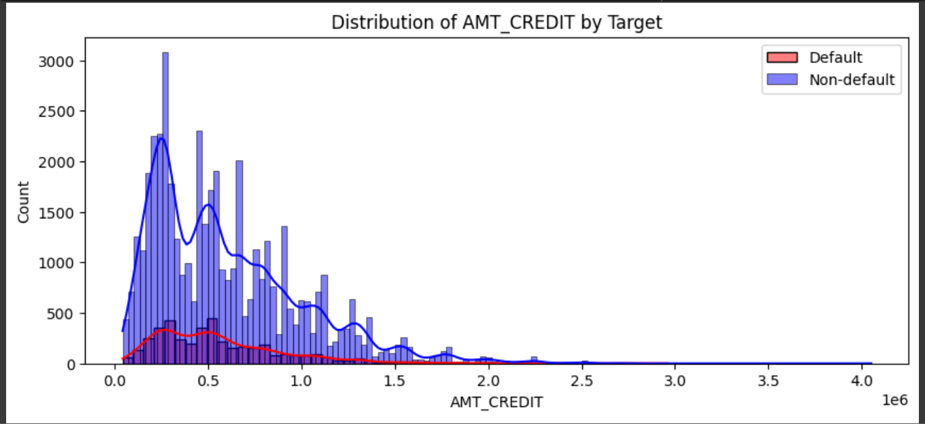
Segmented Univariate Analysis

Slide 33
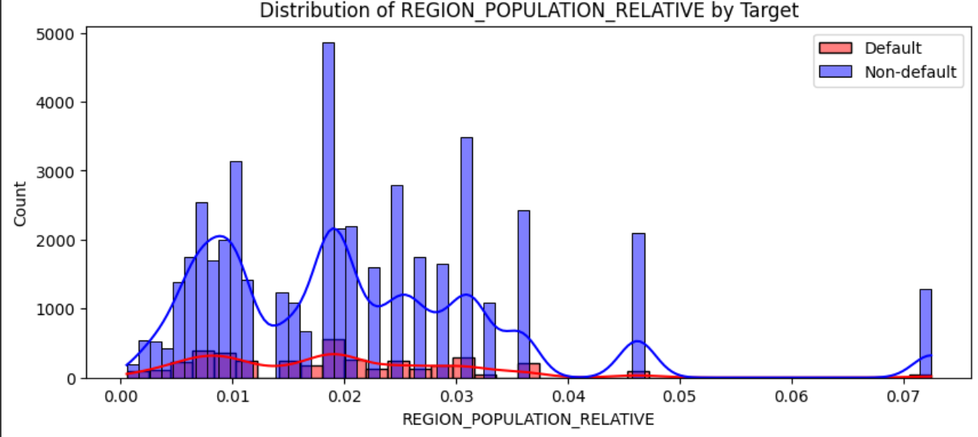
Segmented Univariate Analysis

Slide 34
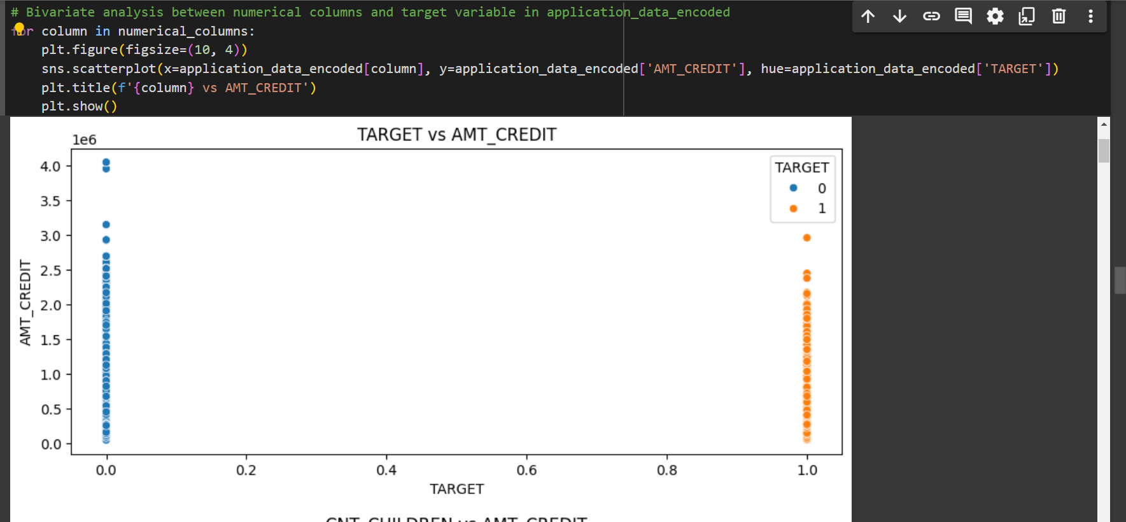
Bivariate Analysis
Using Python

Slide 35
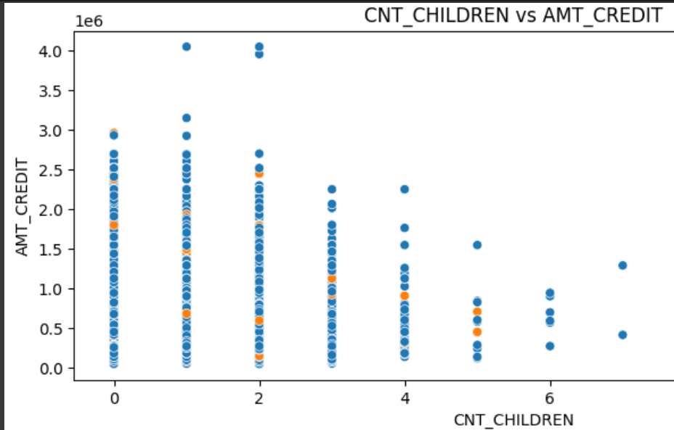
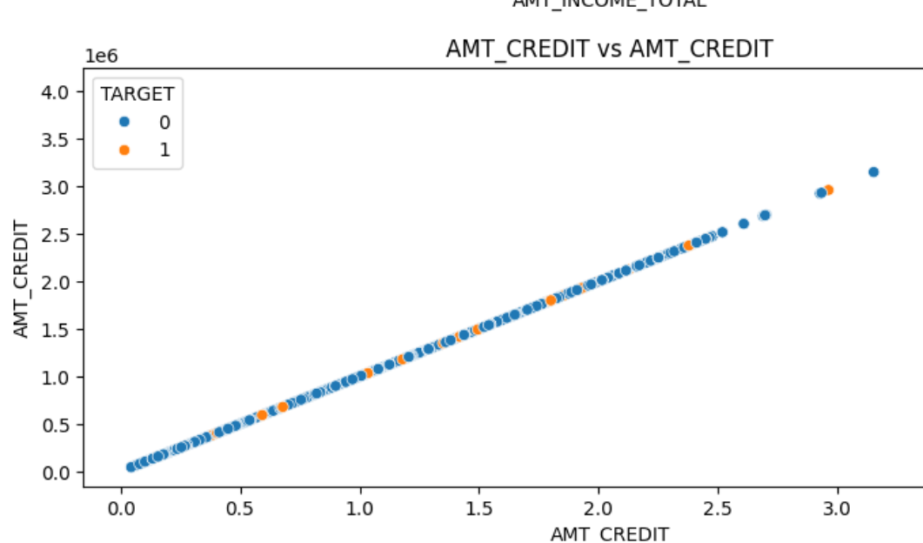
Bivariate Analysis

Slide 36
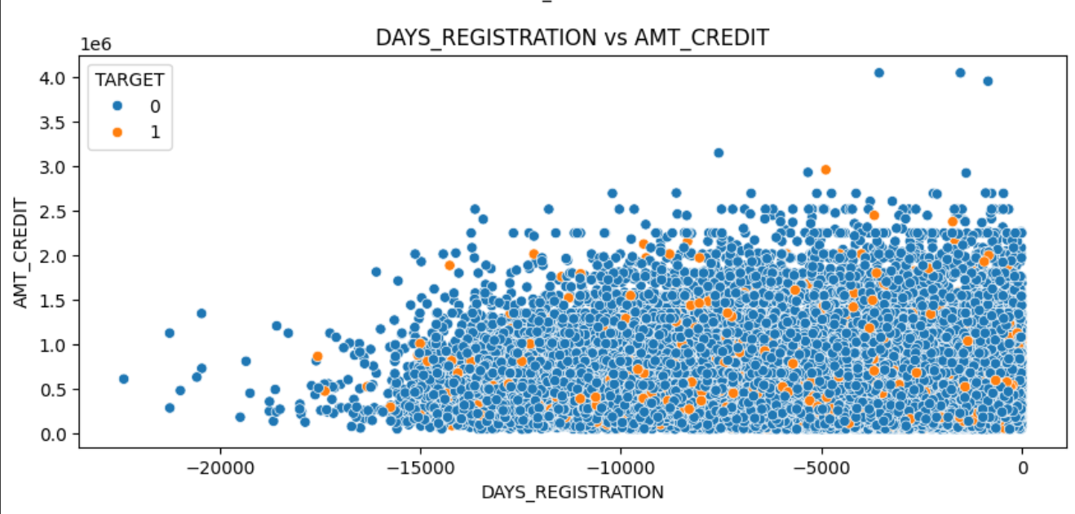
Bivariate Analysis

Slide 37
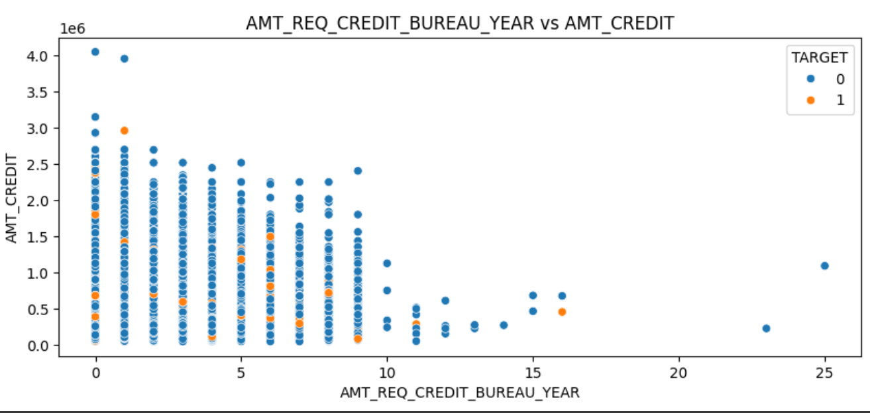
Bivariate Analysis

Slide 38
Task 5
Identify Top Correlations for Different Scenarios

Slide 39
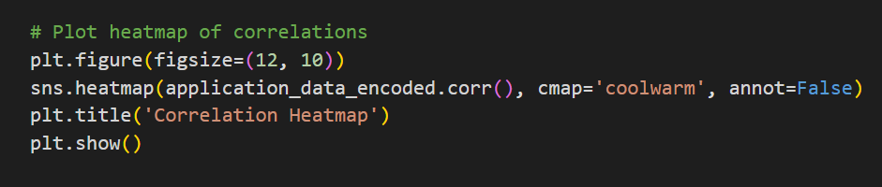
5. Identify Top Correlations for Different Scenarios
Correlation Coefficient: Measure the strength and direction of the relationship between two numerical variables.
In excel we use the =CORREL(A:A, B:B) formula
In python we use .corr() function and plot heatmap

Slide 40
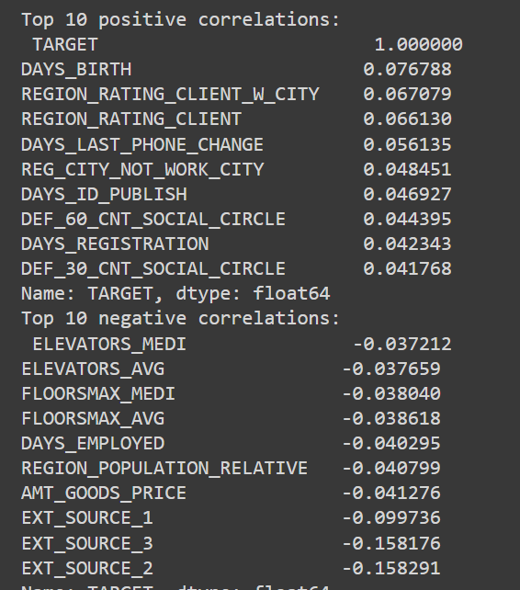
5. Identify Top Correlations for Different Scenarios
Top 10 positive and negative correlations using Python
Positive Correlation
When two variables have a positive correlation, they tend to increase or decrease together. As one variable increases, the other variable also increases. A positive correlation coefficient ranges from 0 to +1.
Negative Correlation
When two variables have a negative correlation, one variable tends to increase while the other variable decreases. As one variable increases, the other variable tends to decrease. A negative correlation coefficient ranges from -1 to 0

Slide 41
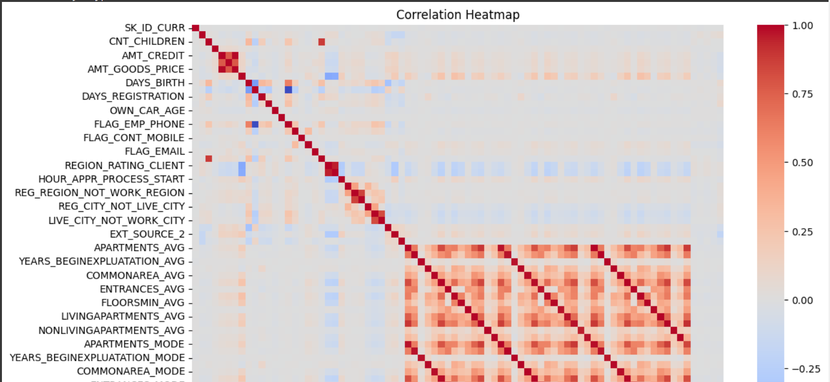
5. Identify Top Correlations for Different Scenarios

Slide 42
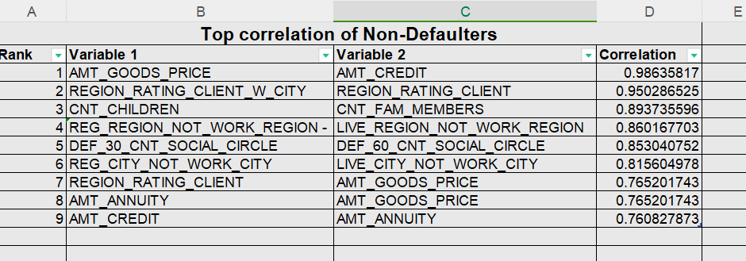
5. Identify Top Correlations for Different Scenarios

Slide 43
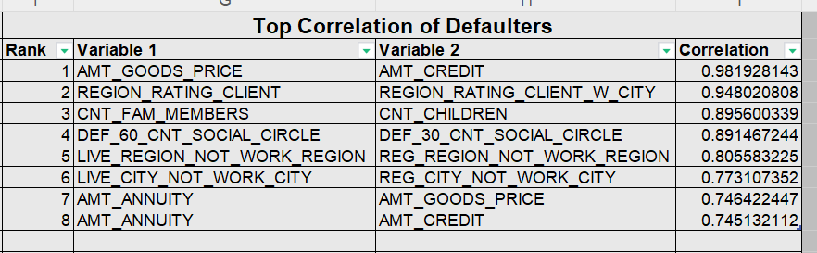
5. Identify Top Correlations for Different Scenarios

Slide 44
Project Report

Slide 45
Project Description
The primary goal of this project is to analyze loan application data to identify patterns and factors that influence loan default. This analysis aims to help the finance company make better decisions regarding loan approvals and mitigate risks associated with defaults
Given dataset includes information on loan applications, customer attributes, and loan attributes
The analysis will cover missing data, outliers, data imbalance, and the relationship between variables and loan default

Slide 46
Approach
Importing and understanding all the columns in the data, also learnt risk analytics in banks
Removing any null/blank values from data (did not found any here)
Check for missing values and decide how to handle them
Load data in jupyter notebook to perform analysis
Perform outlier detection using python code( as I didn’t have ‘Boxes and Whisker’ feature in this version of WPS office)
Visualize the plots using matplotlib/plotly
Perform the Data analytics tasks using Excel/WPS and Python
Make a report from all the analysis and note down all the results

Slide 47
Tech-Stack Used
WPS OFFICE version 12.2.0
Python3 - ipykernel from Anaconda
Pandas, matplotlib, plotly graph-objects, plotly-express libraries
Jupyter-notebook
Google Collaboratory
Jupyter-notebook links -
https://colab.research.google.com/drive/1T4tAiiMnUMS94qaUA6nI4s6j4WFMnlLS?usp=sharing
https://drive.google.com/file/d/1XFpzR83ZUhTlvuML-enH1TvHRqauB_3Y/view?usp=sharing

Slide 48
Insights
Missing Data: Identify the variables with the most missing data and the chosen method for imputation. Discuss how the missing data might impact the analysis.
Outliers: Highlight the numerical variables with significant outliers and their potential impact on the analysis. Discuss whether outliers are valid or require further investigation.
Data Imbalance: Discuss the proportion of each class (e.g., Approved, Cancelled, Refused, Unused Offer) and its potential impact on model accuracy.
Univariate Analysis: Summarize insights from the distribution of individual variables. Identify any notable patterns or anomalies.
Segmented Univariate Analysis: Compare distributions across different scenarios to understand how attributes differ for various loan outcomes.
Bivariate Analysis: Explain the relationships between variables and loan default. Identify key factors that are strongly correlated with default.

Slide 49
Result
Decision-Making: Provide recommendations based on the analysis. For example, suggest criteria for approving or denying loans based on risk factors identified.
Risk Mitigation: Offer strategies to reduce loan default risks, such as adjusting loan amounts, interest rates, or implementing stricter approval criteria for high-risk applicants.
Model Improvement: Discuss how the insights gained can be used to improve predictive models for loan default.
Impact:
Highlight how the analysis contributes to better decision-making and risk management in the finance company. Explain the potential business impact of implementing the recommendations.

Slide 50
Video
Presentation Link
Please refer to this link for my video presentation: https://www.loom.com/share/0009676da9a44de6b3236e5efc715ea8?sid=8b68a7e0-6fdb-4cdd-a40c-1289ece4a6ed

Slide 51
Thank You
Project by Gayatri Palkar

